Slide 1
Tissue specific gene sets
Stephen Coleman
23/07/2019

Slide 2
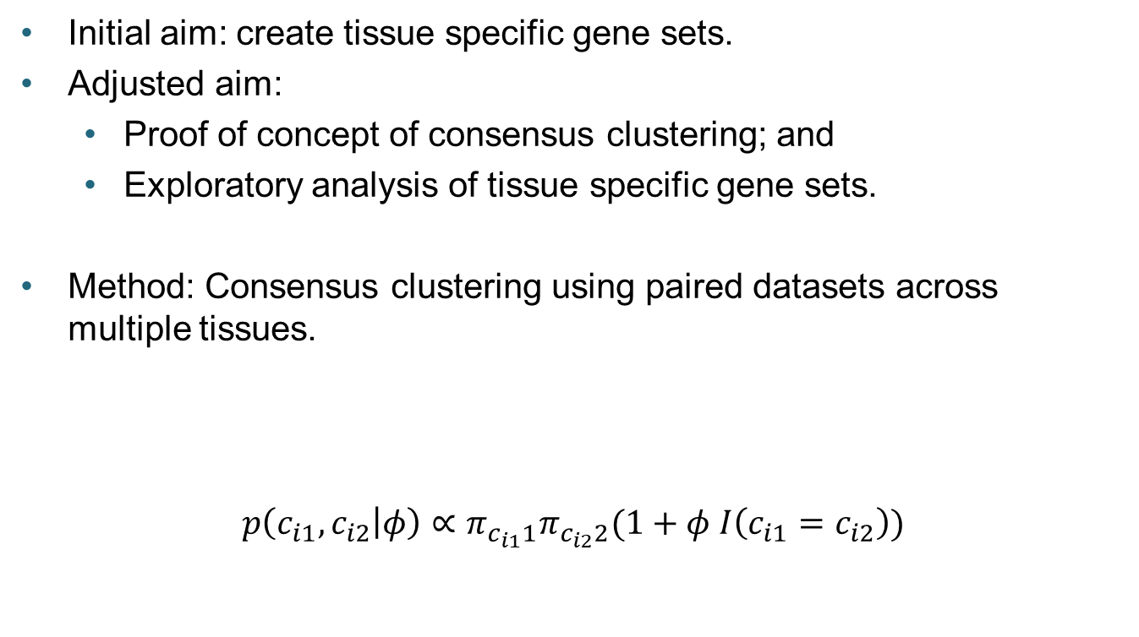
Overview
Initial aim: create tissue specific gene sets.
Adjusted aim:
Proof of concept of consensus clustering; and
Exploratory analysis of tissue specific gene sets.
Method: Consensus clustering using paired datasets across multiple tissues.
$$p\left(c_{i1}, c_{i2} | φ\right)∝π_{c_{i1}1}π_{c_{i2}2}(1+φ I\left(c_{i1}=c_{i2}\right))$$

Slide 3
Gene sets
Correlated expression (co-expression) between genes is often an indicator that they are:
Controlled by the same transcription factor;
Functionally related; or
Members of the same pathway [1].
Many diseases are polygenic [2].
Within a single metabolic pathway an increase of 20% in all the associated gene products may have more impact upon phenotype than a 20-fold increase in a single gene [3].

Slide 4
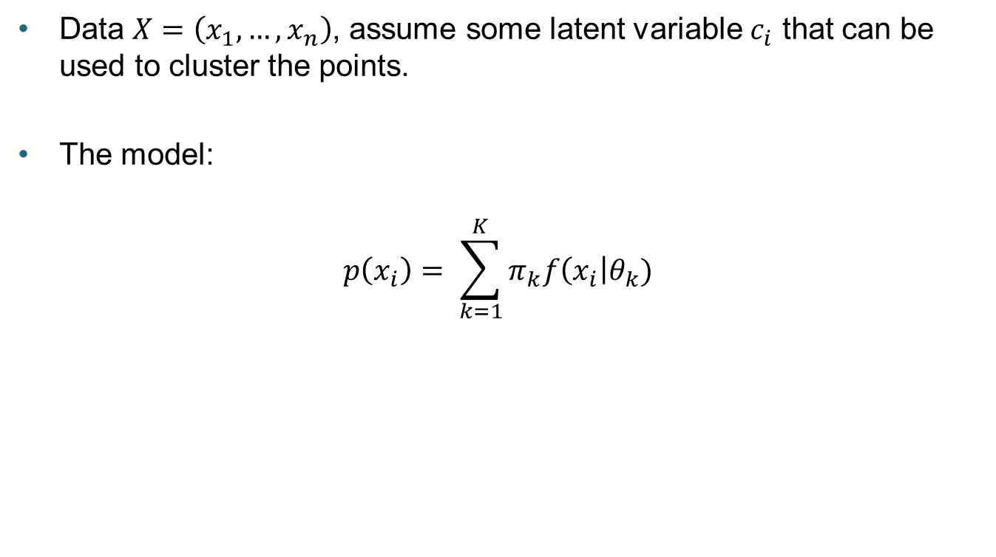
Mixture models
Data $X=\left(x_{1},…, x_{n}\right)$, assume some latent variable $c_{i}$ that can be used to cluster the points.
The model:
$$p\left(x_{i}\right)= \sum_{k=1}^{K}{π_{k}f\left(x_{i}\right|θ_{k}) }$$
Mixing proportions
Distribution
parameters
Probability density function

Slide 5
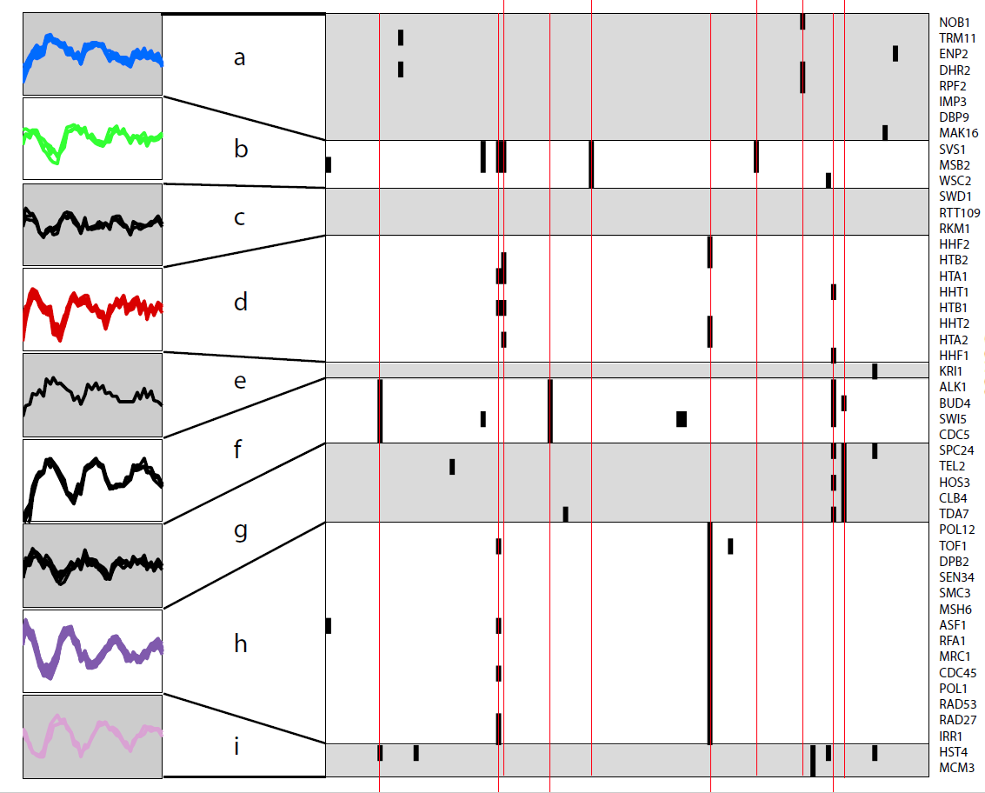
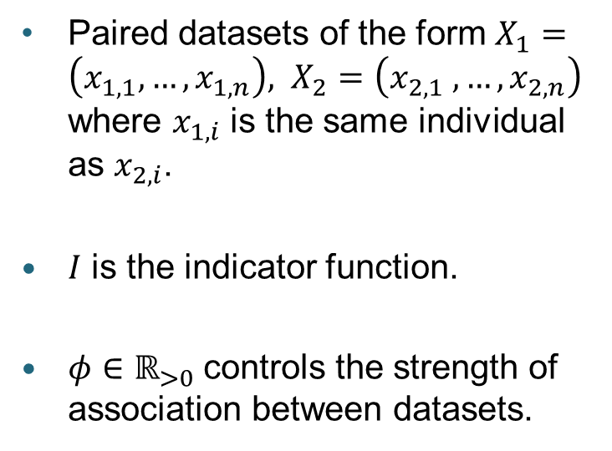
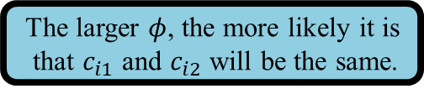

Multiple Dataset Integration
The larger $φ$, the more likely it is
that $c_{i1}$ and $c_{i2}$ will be the same.
MDI [4] clustering is defined by:
$$p\left(c_{i1}, c_{i2} | φ\right)∝π_{c_{i1}1}π_{c_{i2}2}(1+φ I\left(c_{i1}=c_{i2}\right))$$
Paired datasets of the form $X_{1}=\left(x_{1,1},…, x_{1,n}\right), X_{2}=\left(x_{2,1} ,…, x_{2,n}\right)$ where $x_{1,i}$ is the same individual as $x_{2,i}$.
$I$ is the indicator function.
$φ∈ℝ_{>0}$ controls the strength of association between datasets.

Slide 6
Consensus clustering
What about when MCMC struggles to explore the space fully?
In this case the model can be sensitive to initialisation.
Consider an ensemble model of many different initialisations of MDI.
For each sub-model record the parameters for the final iteration; and
Compile these into a final output distribution.
This is consensus clustering [5].

Slide 7
Analysis
Two parts:
Use simulated data to show consensus clustering:
Agrees with MDI when MCMC converges; and
Overcomes “stickiness” of individual modes when MCMC does not converge in a realistic space of time.
Use real gene expression data to explore tissue specific gene set.

Slide 8
Simulations
We simulate data under two scenarios.
Scenario 1 is intended to show that consensus clustering describes a similar space as MDI when convergence is possible.
Scenario 2 is intended to be a testing example of when MDI might struggle and shows consensus clustering does not become “stuck” in the same way.
We can test the quality of clustering as we know the underlying subpopulations the data is generated from.
Compare different versions of consensus clustering to 10 chains of MDI run for 2 million iterations.

Slide 9
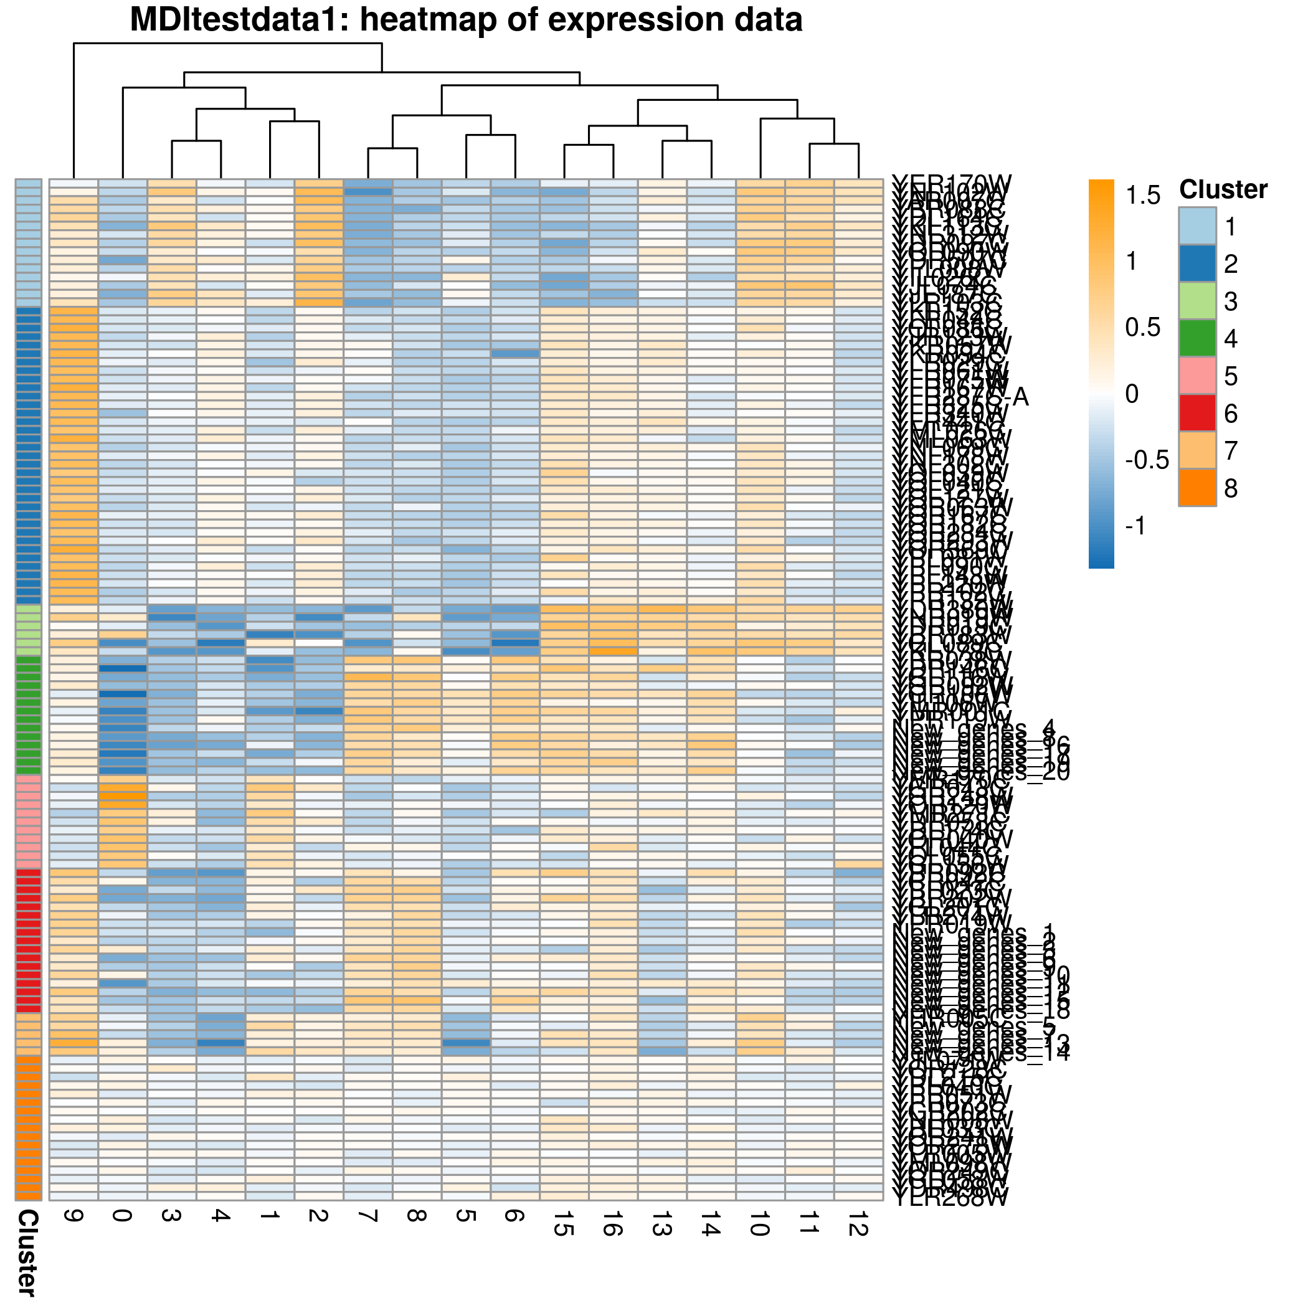
Simulation 1: Data
Based on simulated data from original MDI paper.
Added some noise to be have some uncertainty in the clustering.

Slide 10
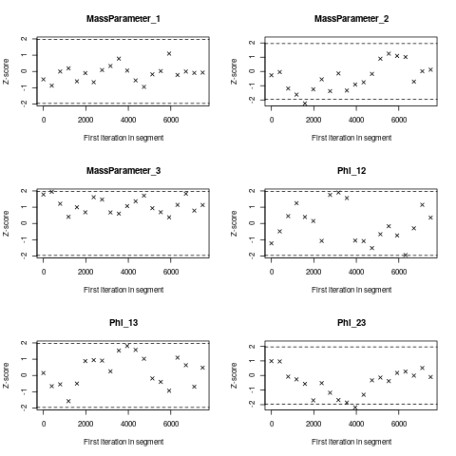
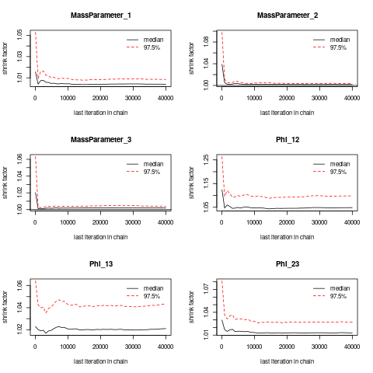
Simulation 1: Convergence

Slide 11
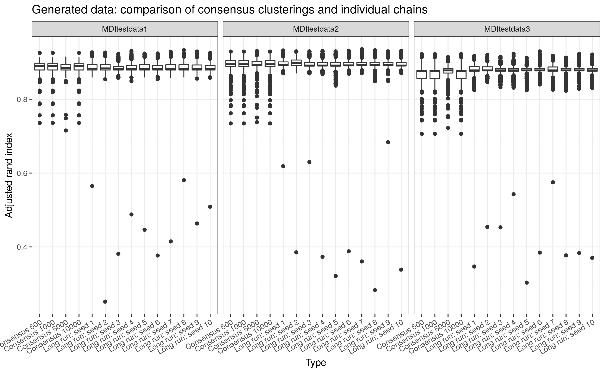
Simulation 1: Clustering quality

Slide 12
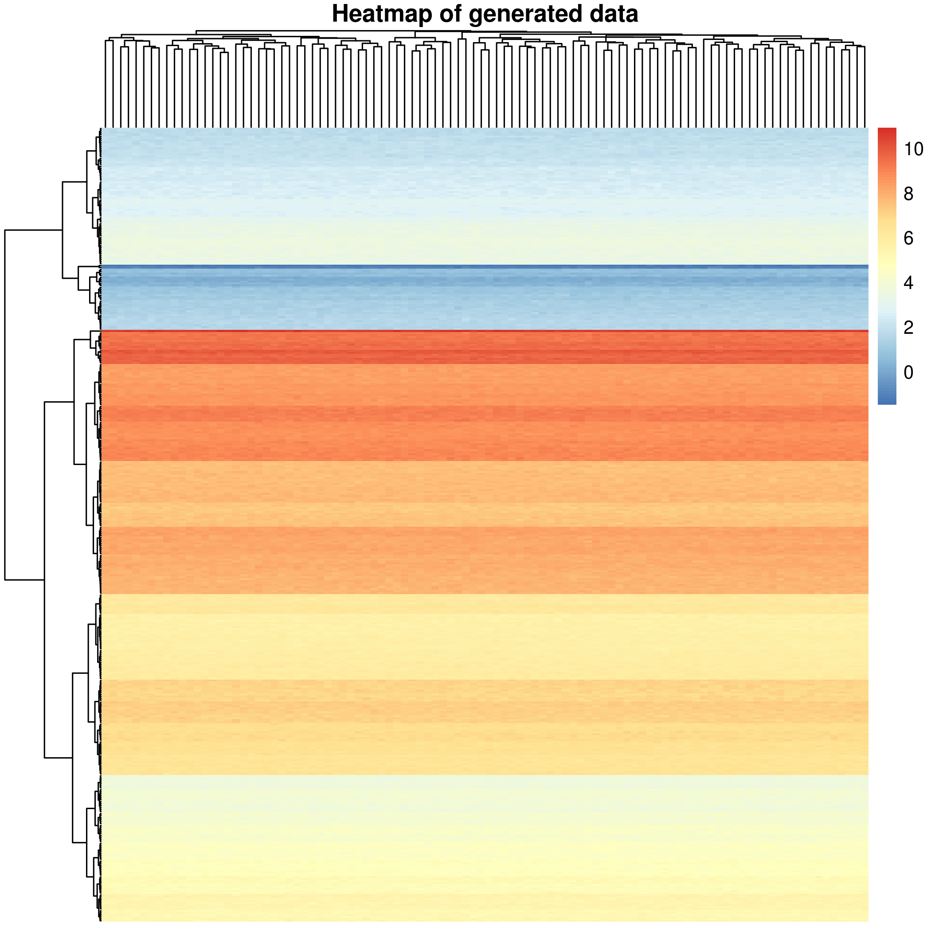
Simulation 2: Data
Data generated from 5 Normal distributions.
Perturbed with white noise to blur boundaries between subpopulations.
Hard to cluster.

Slide 13
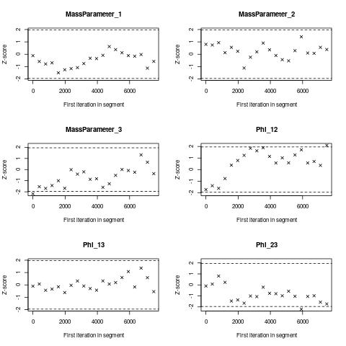
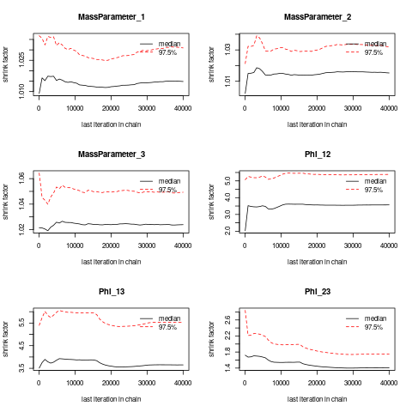
Simulation 2: Convergence

Slide 14
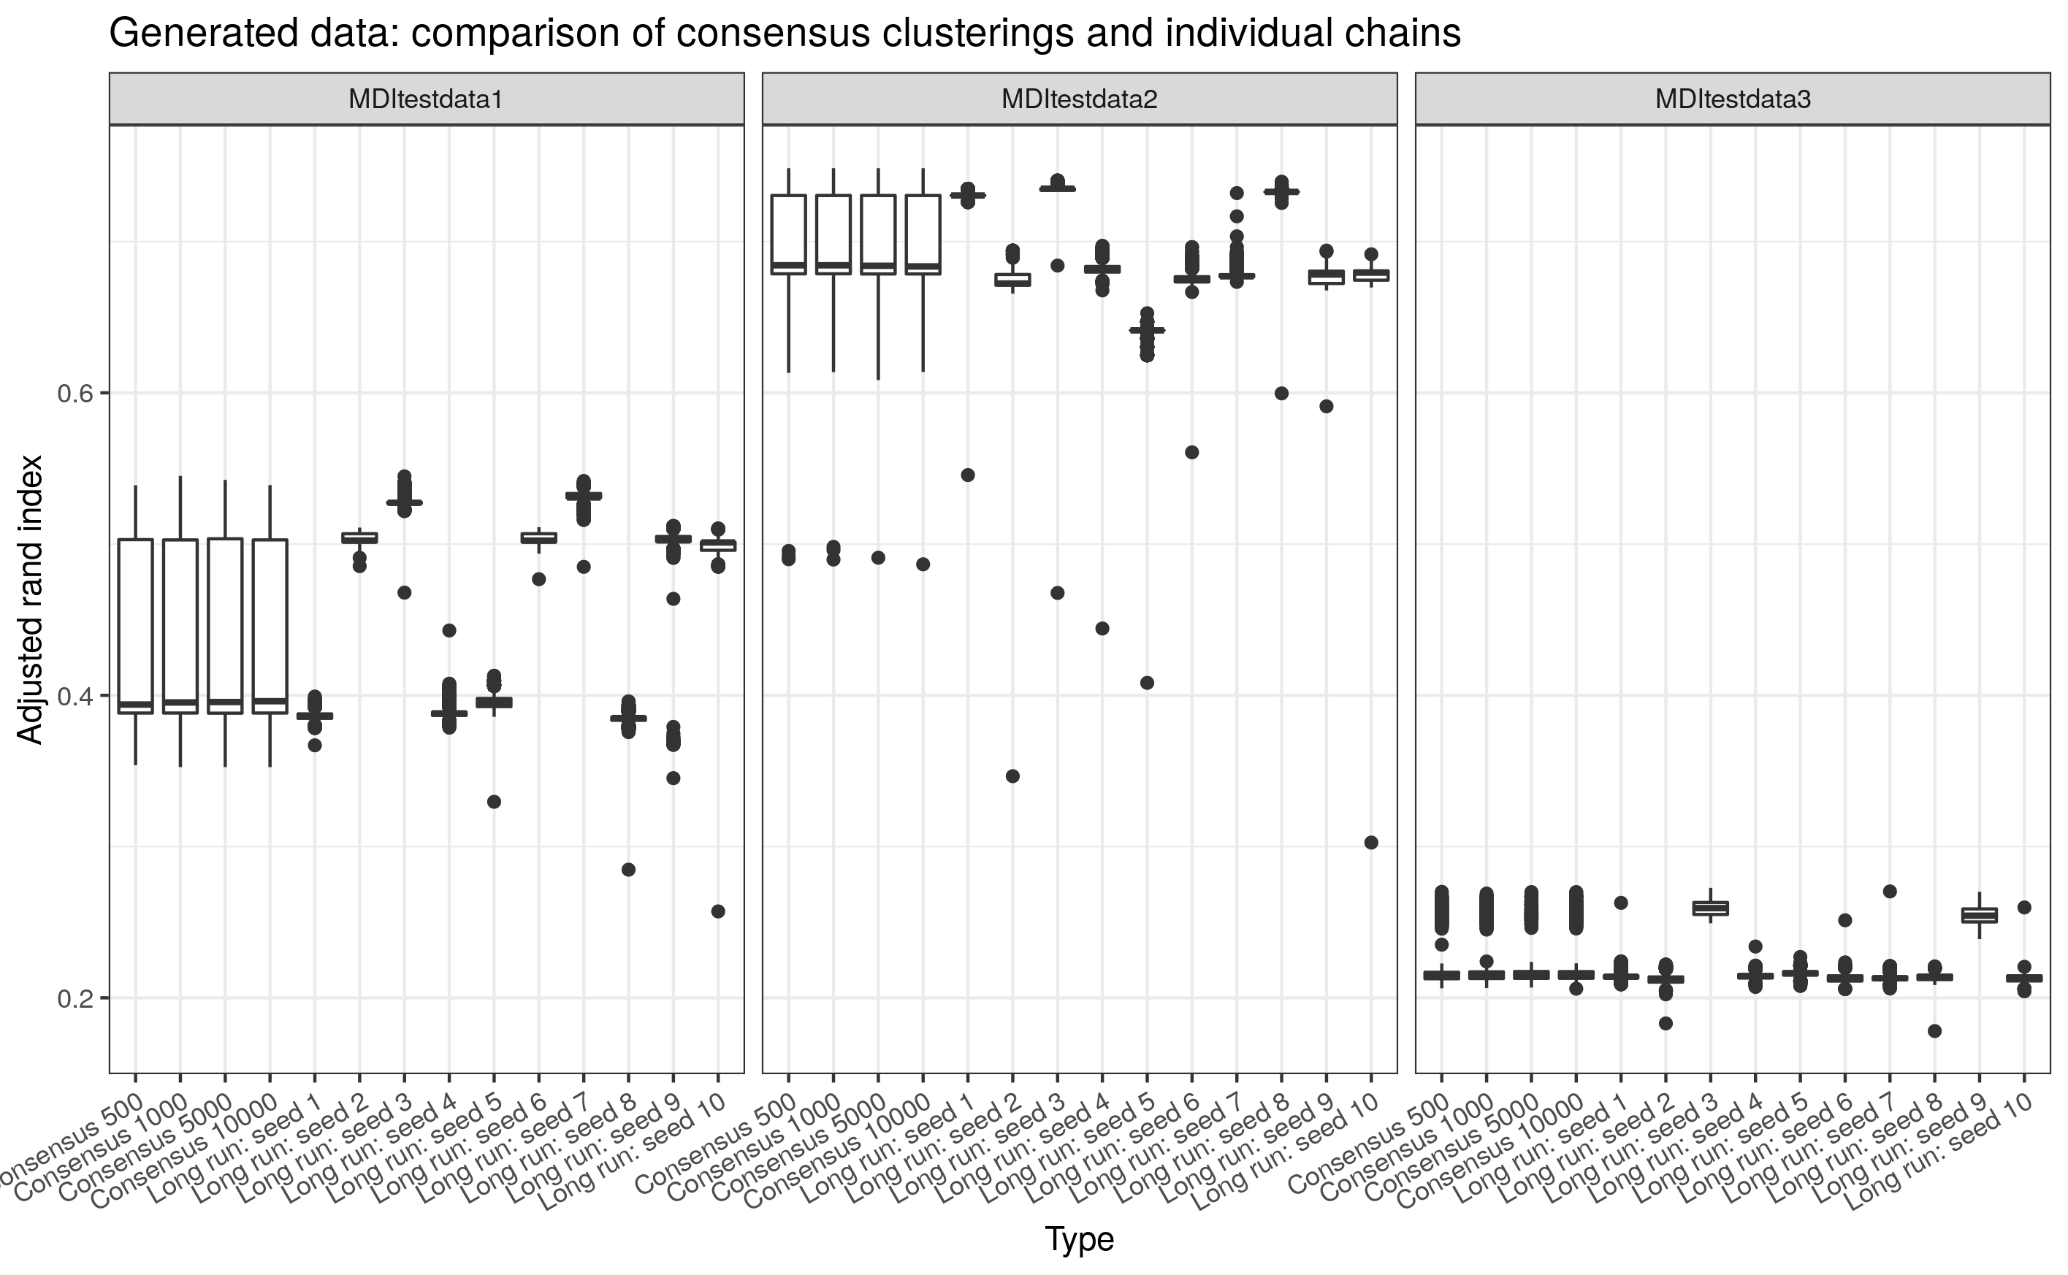
Simulation 2: Clustering

Slide 15
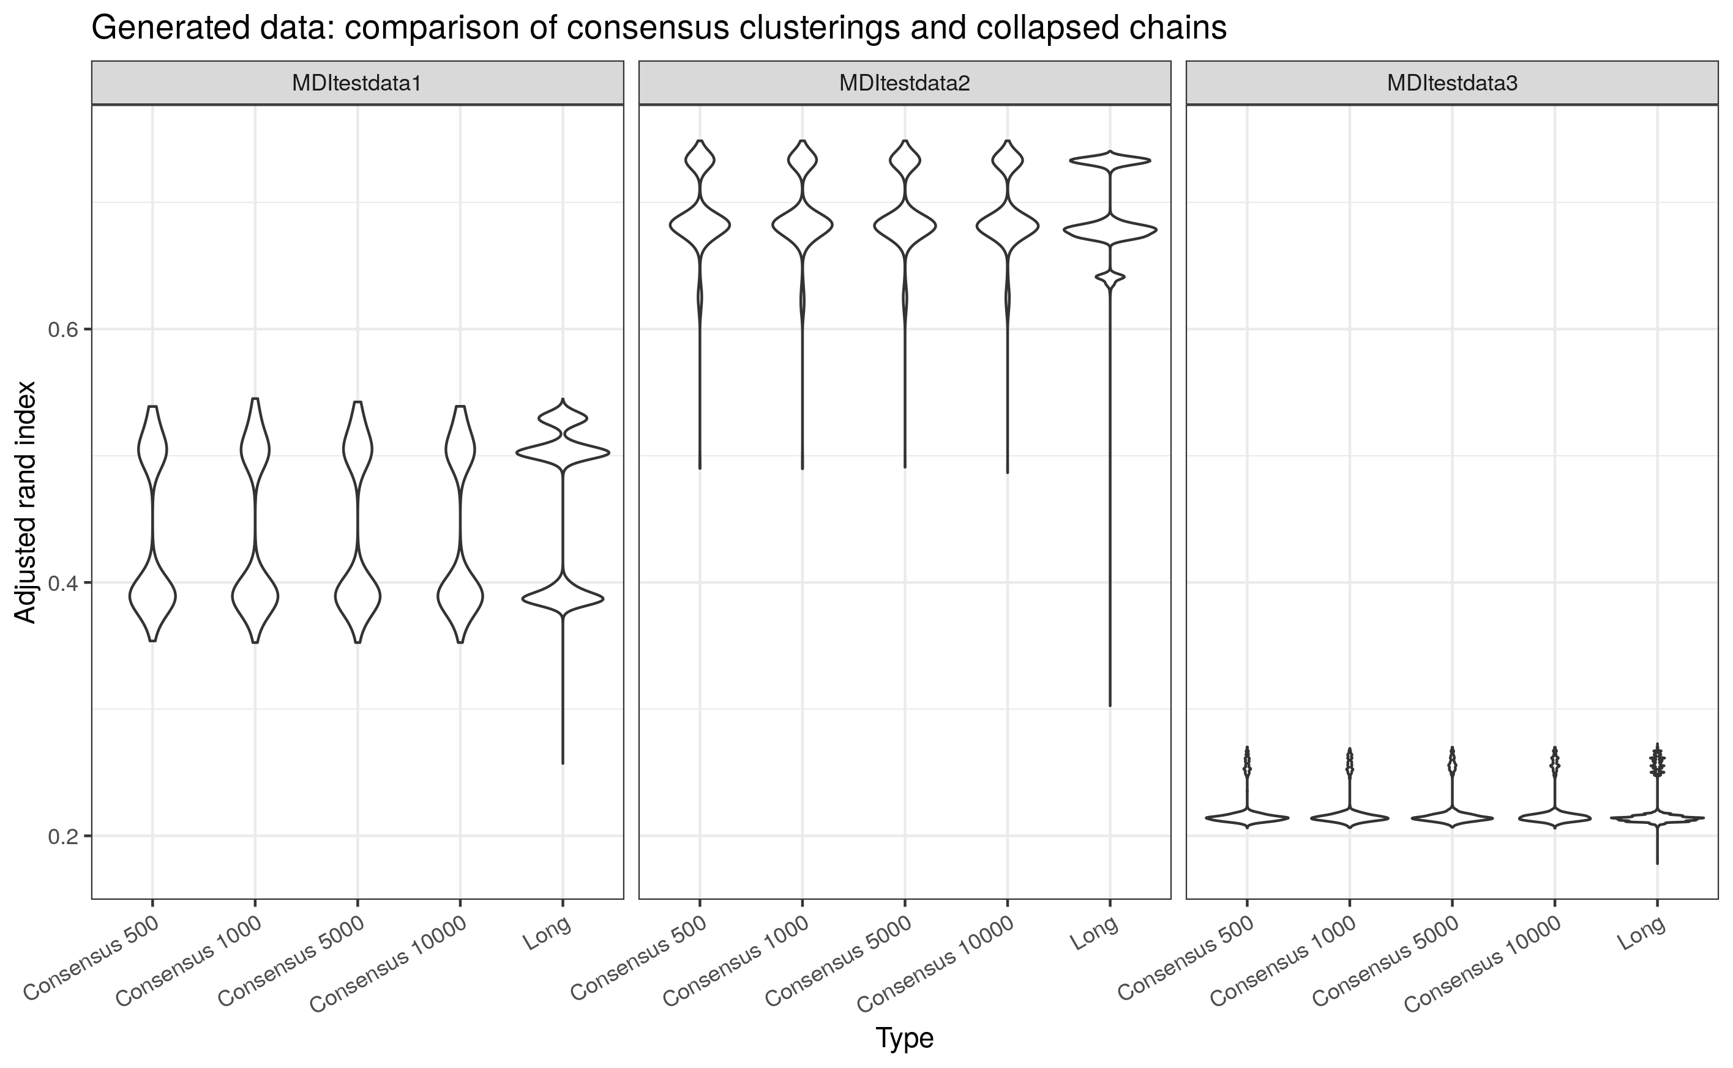
Simulation 2: Clustering

Slide 16
Data
The Correlated Expression and Disease Association Research (CEDAR) dataset [6]
Expression data for 323 healthy individuals across 9 cell types:
6 circulating immune cells; and
3 colonic samples from biopsies.
We have ~18k probes present in the data.
Neither all people or all probes are present in all datasets.

Slide 17
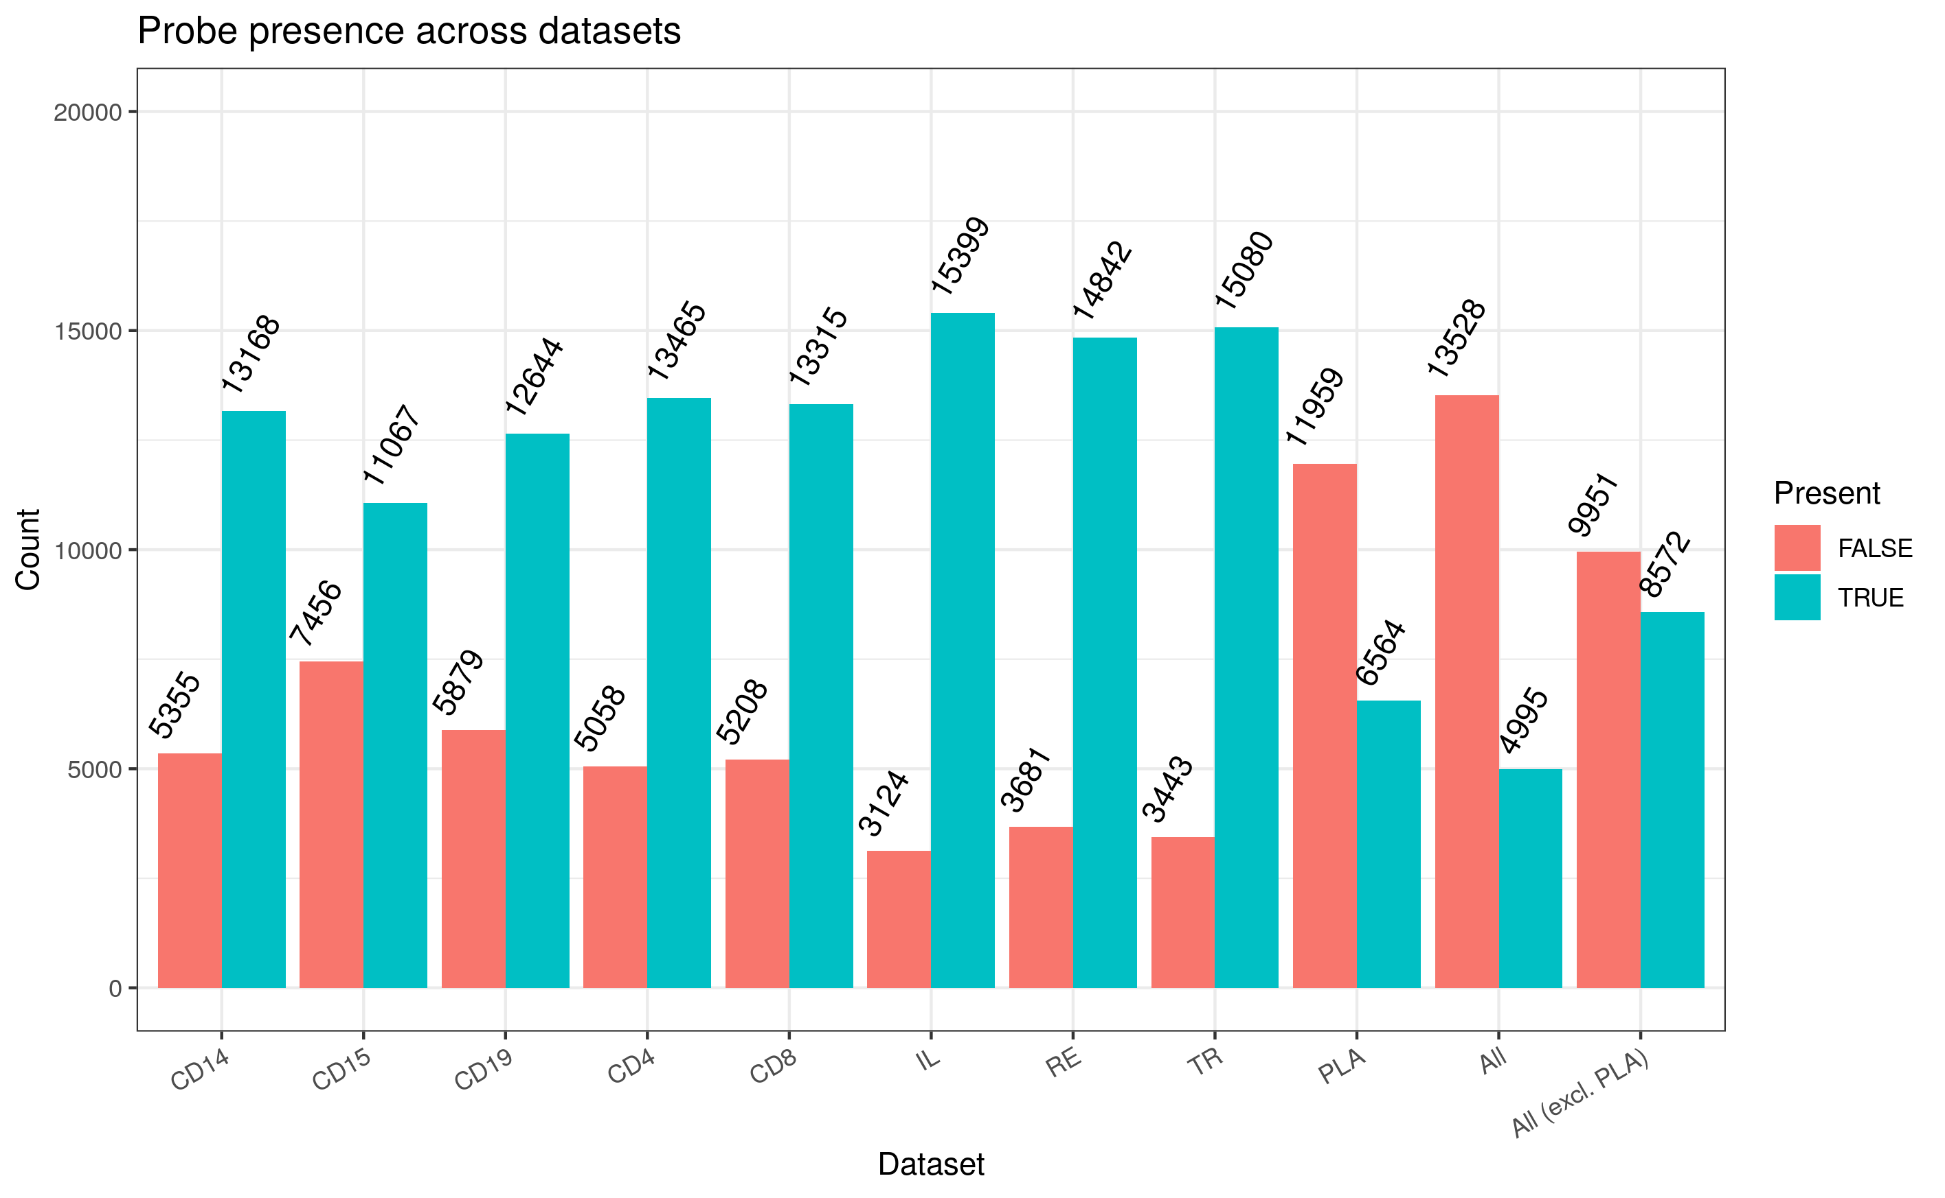
CEDAR: Missingness across datasets

Slide 18
Case studies
Dataset of 250 probes.
Consists of the Inostiol phosphate metabolism pathway as defined on the Kyoto Encyclopaedia of Genes and Genomes (KEGG) and 190 random other probes.
Dataset of 1,000 probes.
Consists of three KEGG pathways:
Inflammatory bowel disease;
Nod-like receptor signalling; and
Inostiol phosphate metabolism.
The union of these sets amounts to 237 probes. The final dataset uses a further 763 random probes.

Slide 19
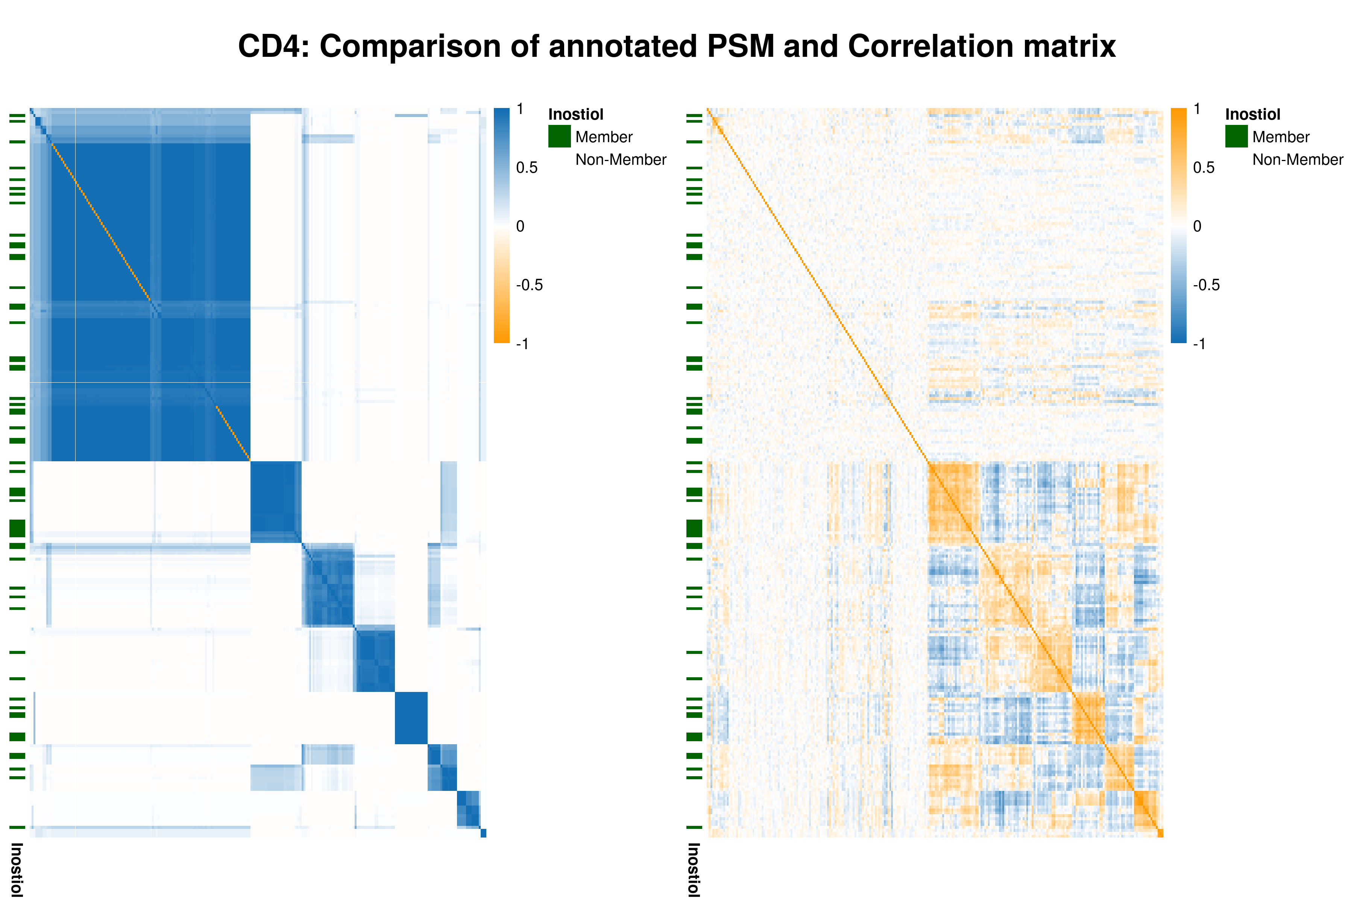
CEDAR 1: Results

Slide 20
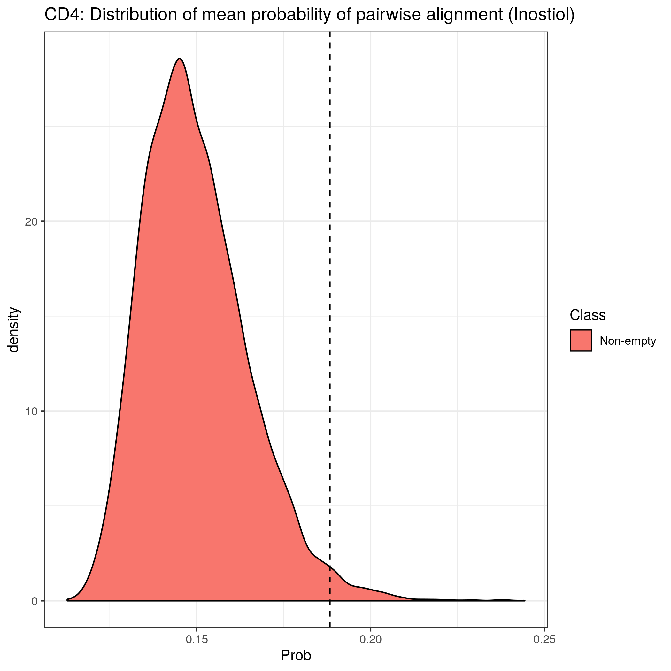
CEDAR 1: Results
Compare mean pairwise probability of alignment for 60 inositol genes to sets of 60 other genes.
Indicative that the clustering of the inositol genes is non-random.

Slide 21
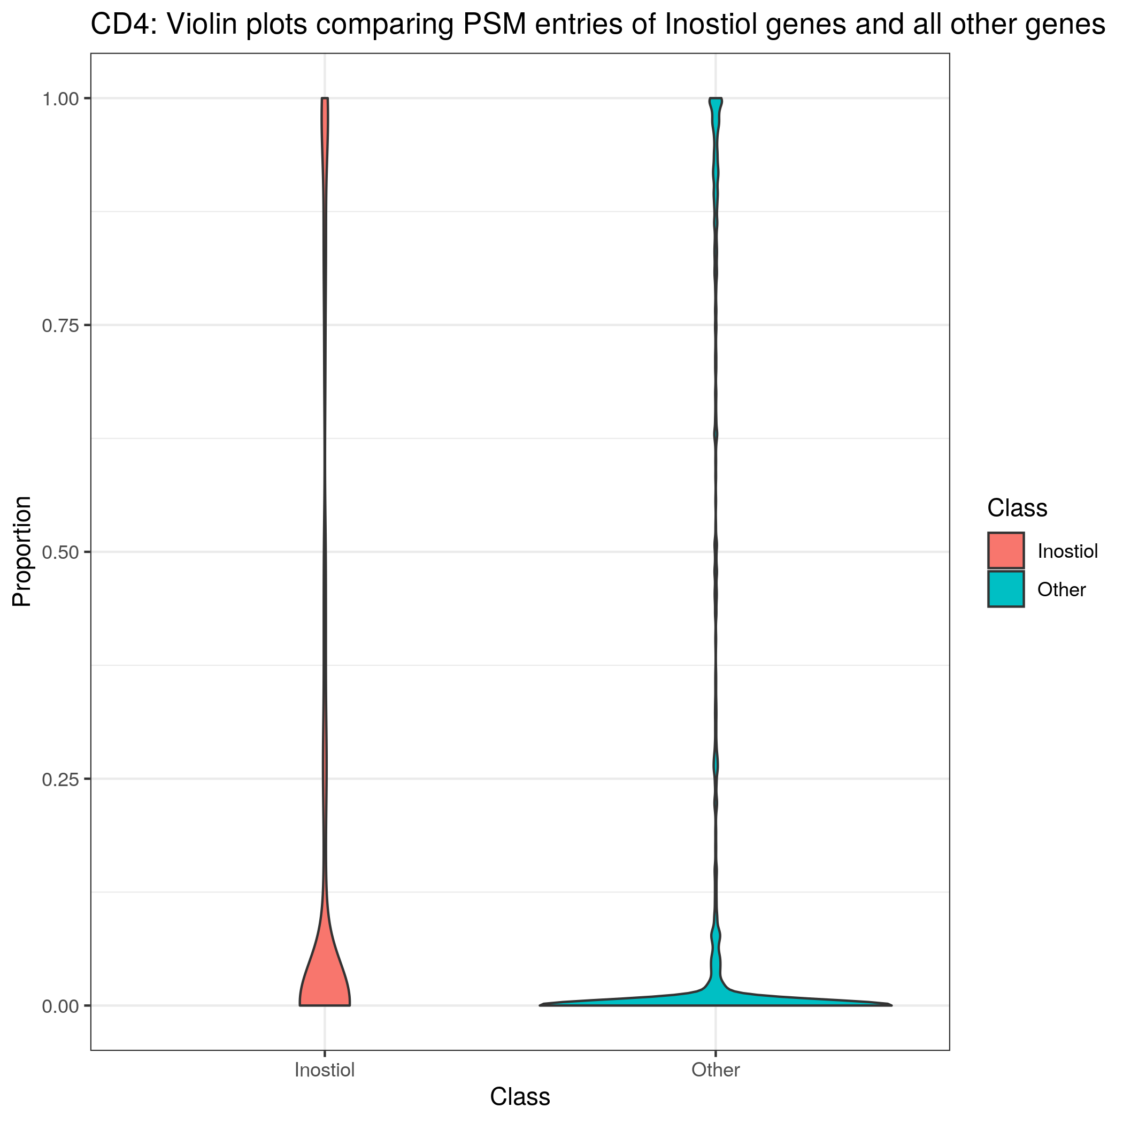
CEDAR 1: Results
Distribution of entries in the PSM for the inositol genes compared to all others.
Indicative that the clustering of the inositol genes is non-random.

Slide 22
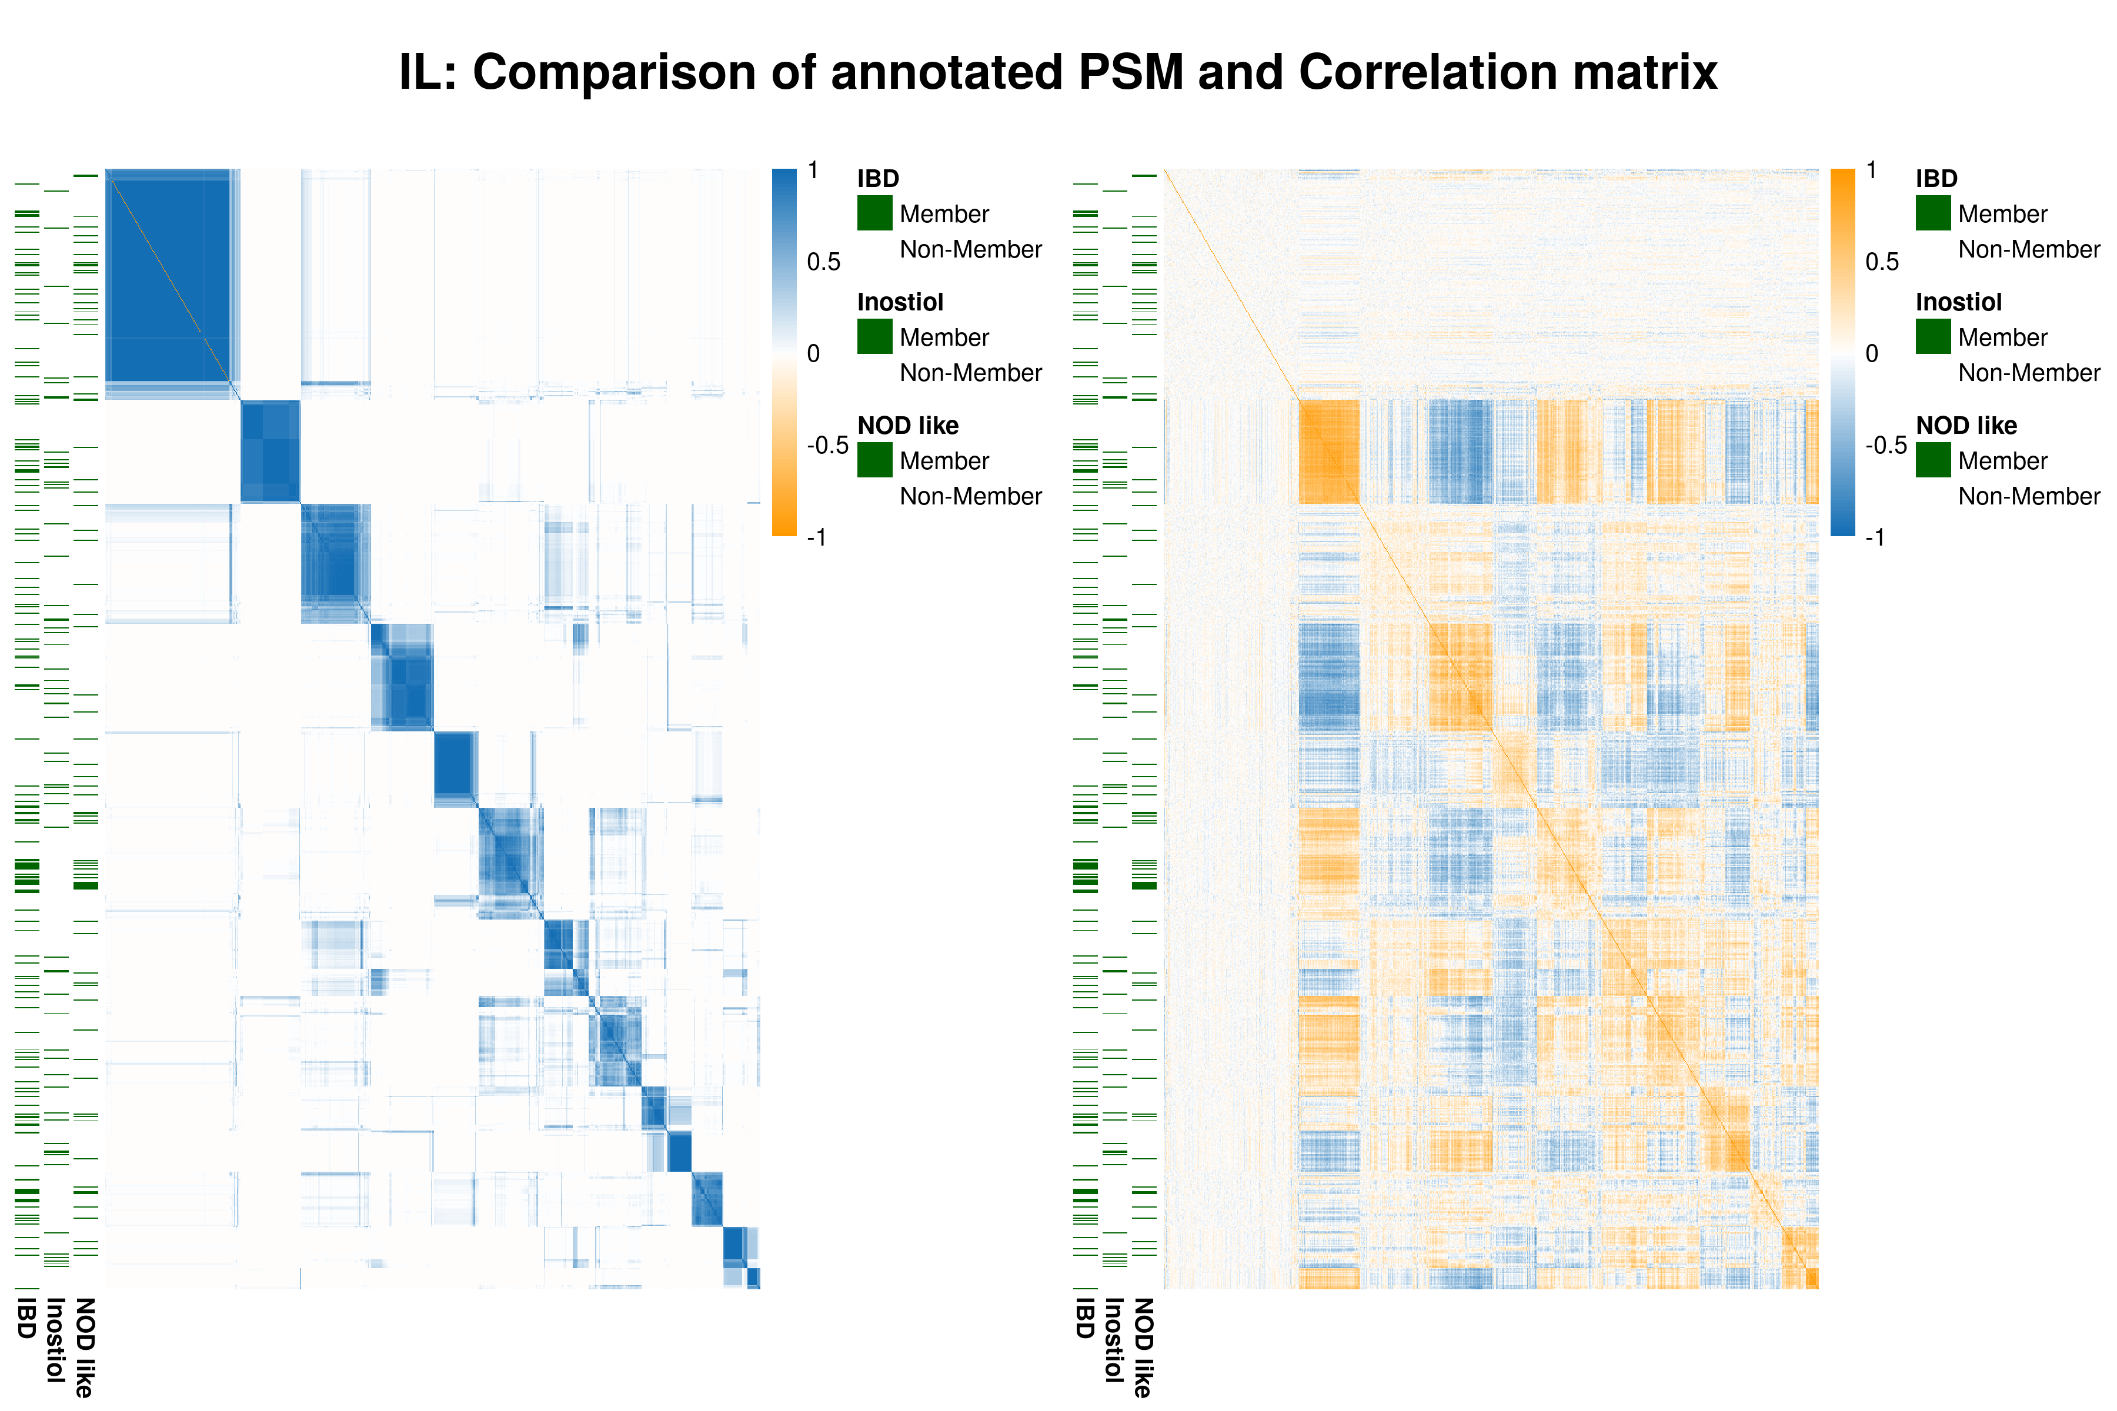
CEDAR 2: Results

Slide 23
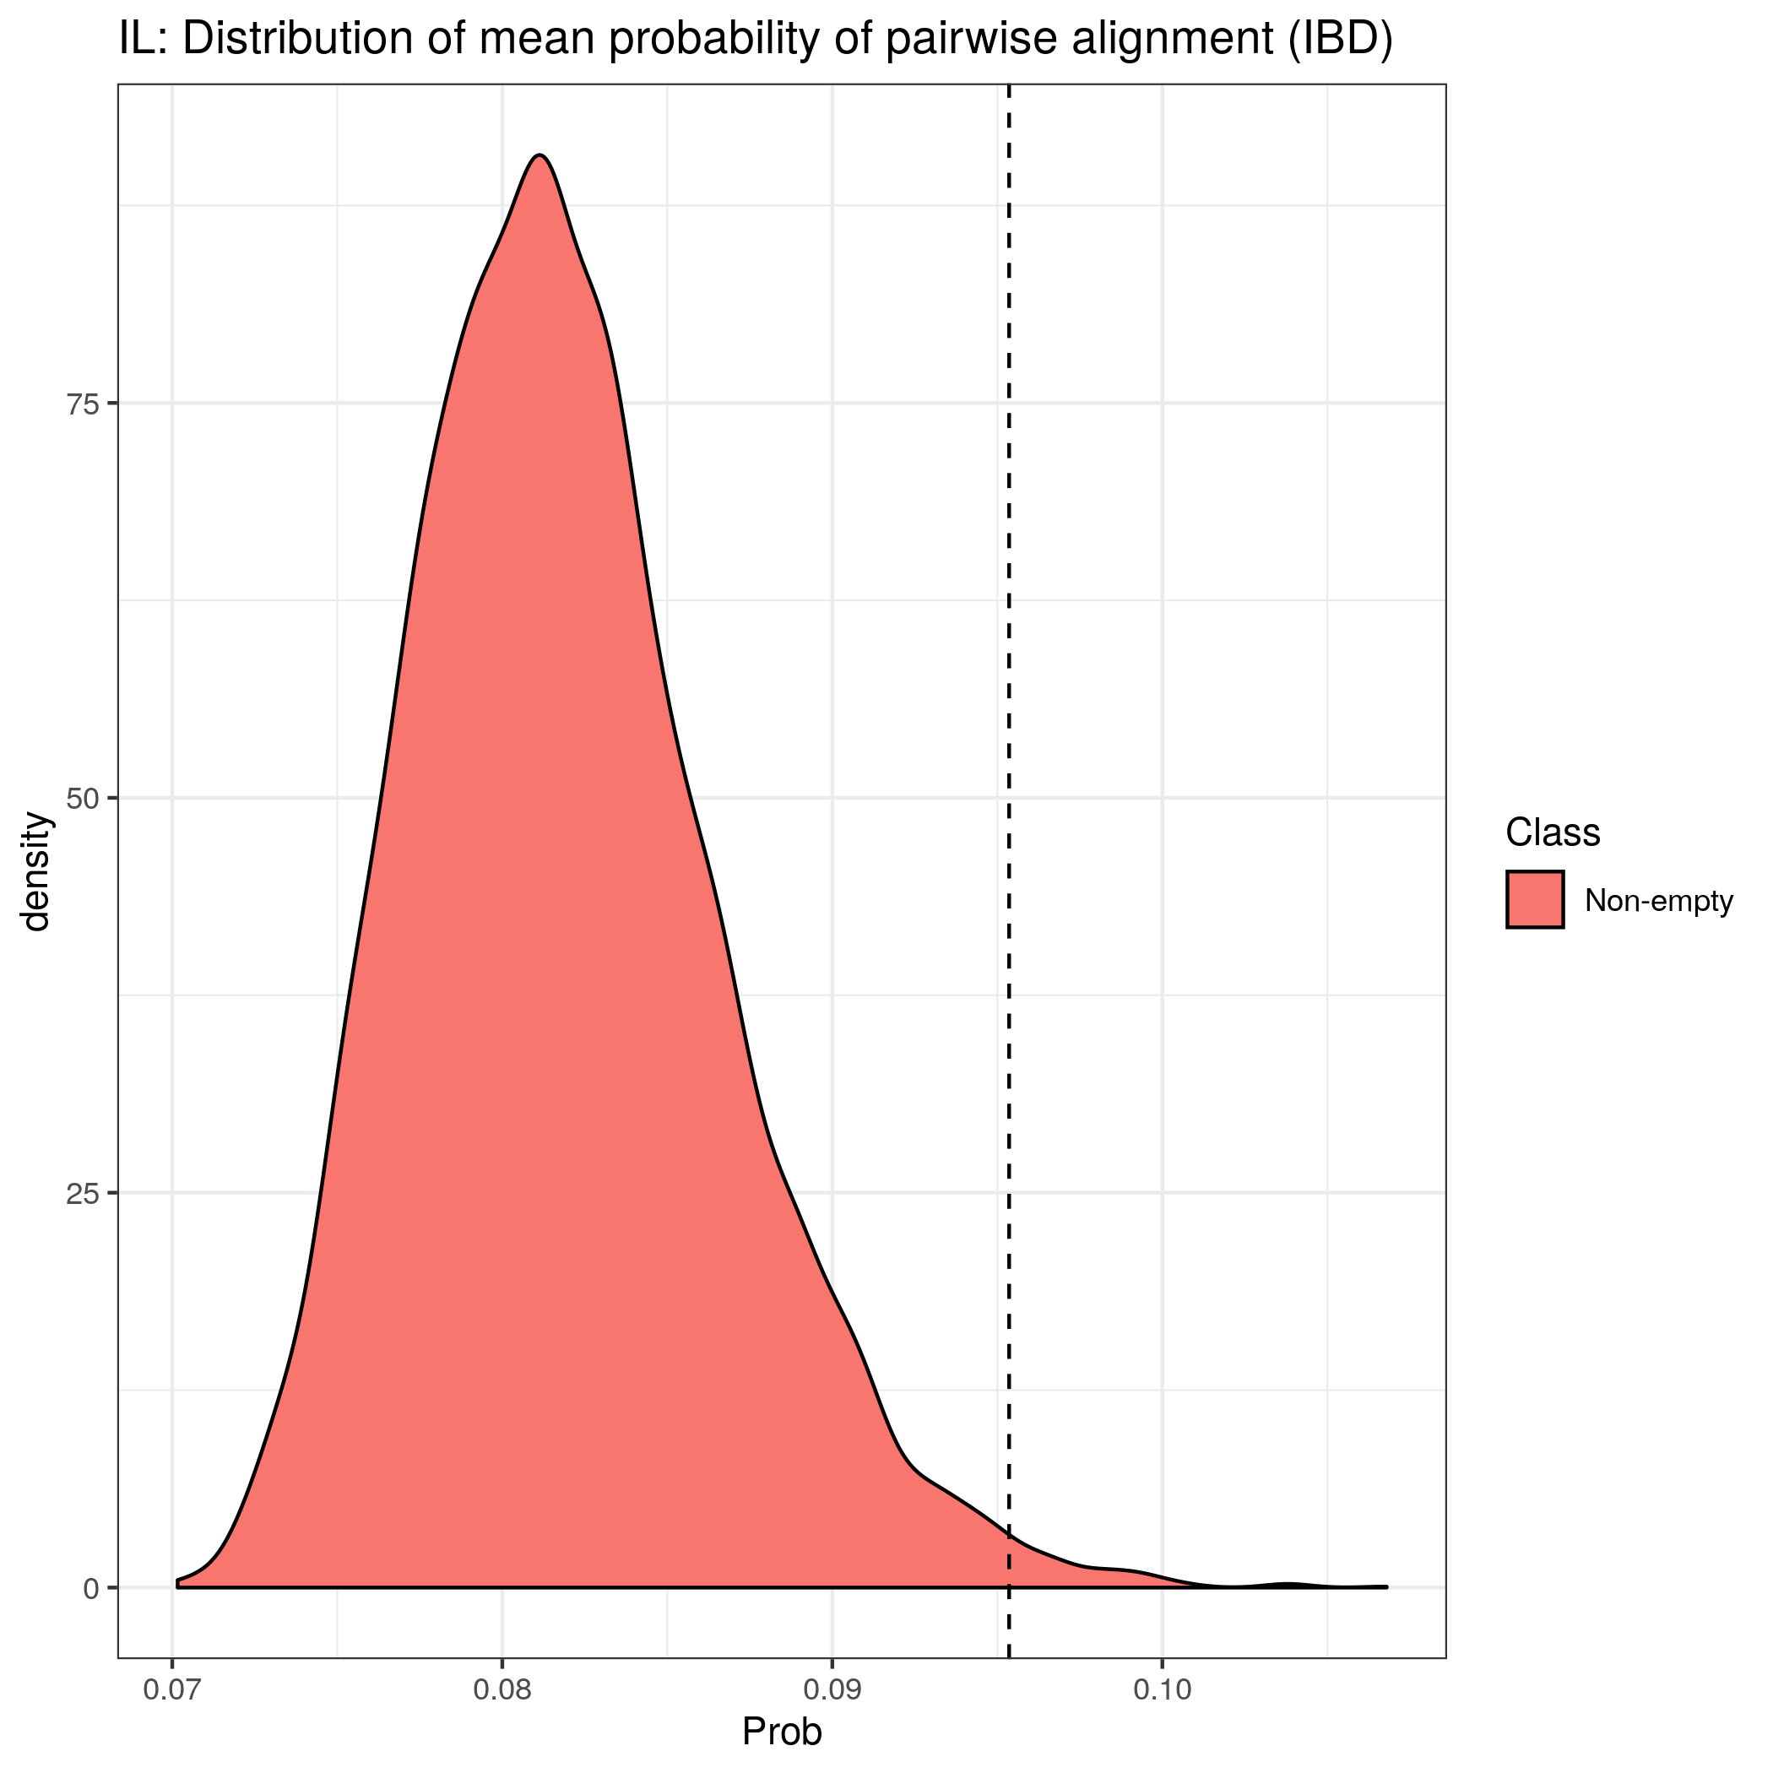
CEDAR 2: Results
Compare mean pairwise probability of alignment for IBD genes in IL.
Encouraging result.

Slide 24
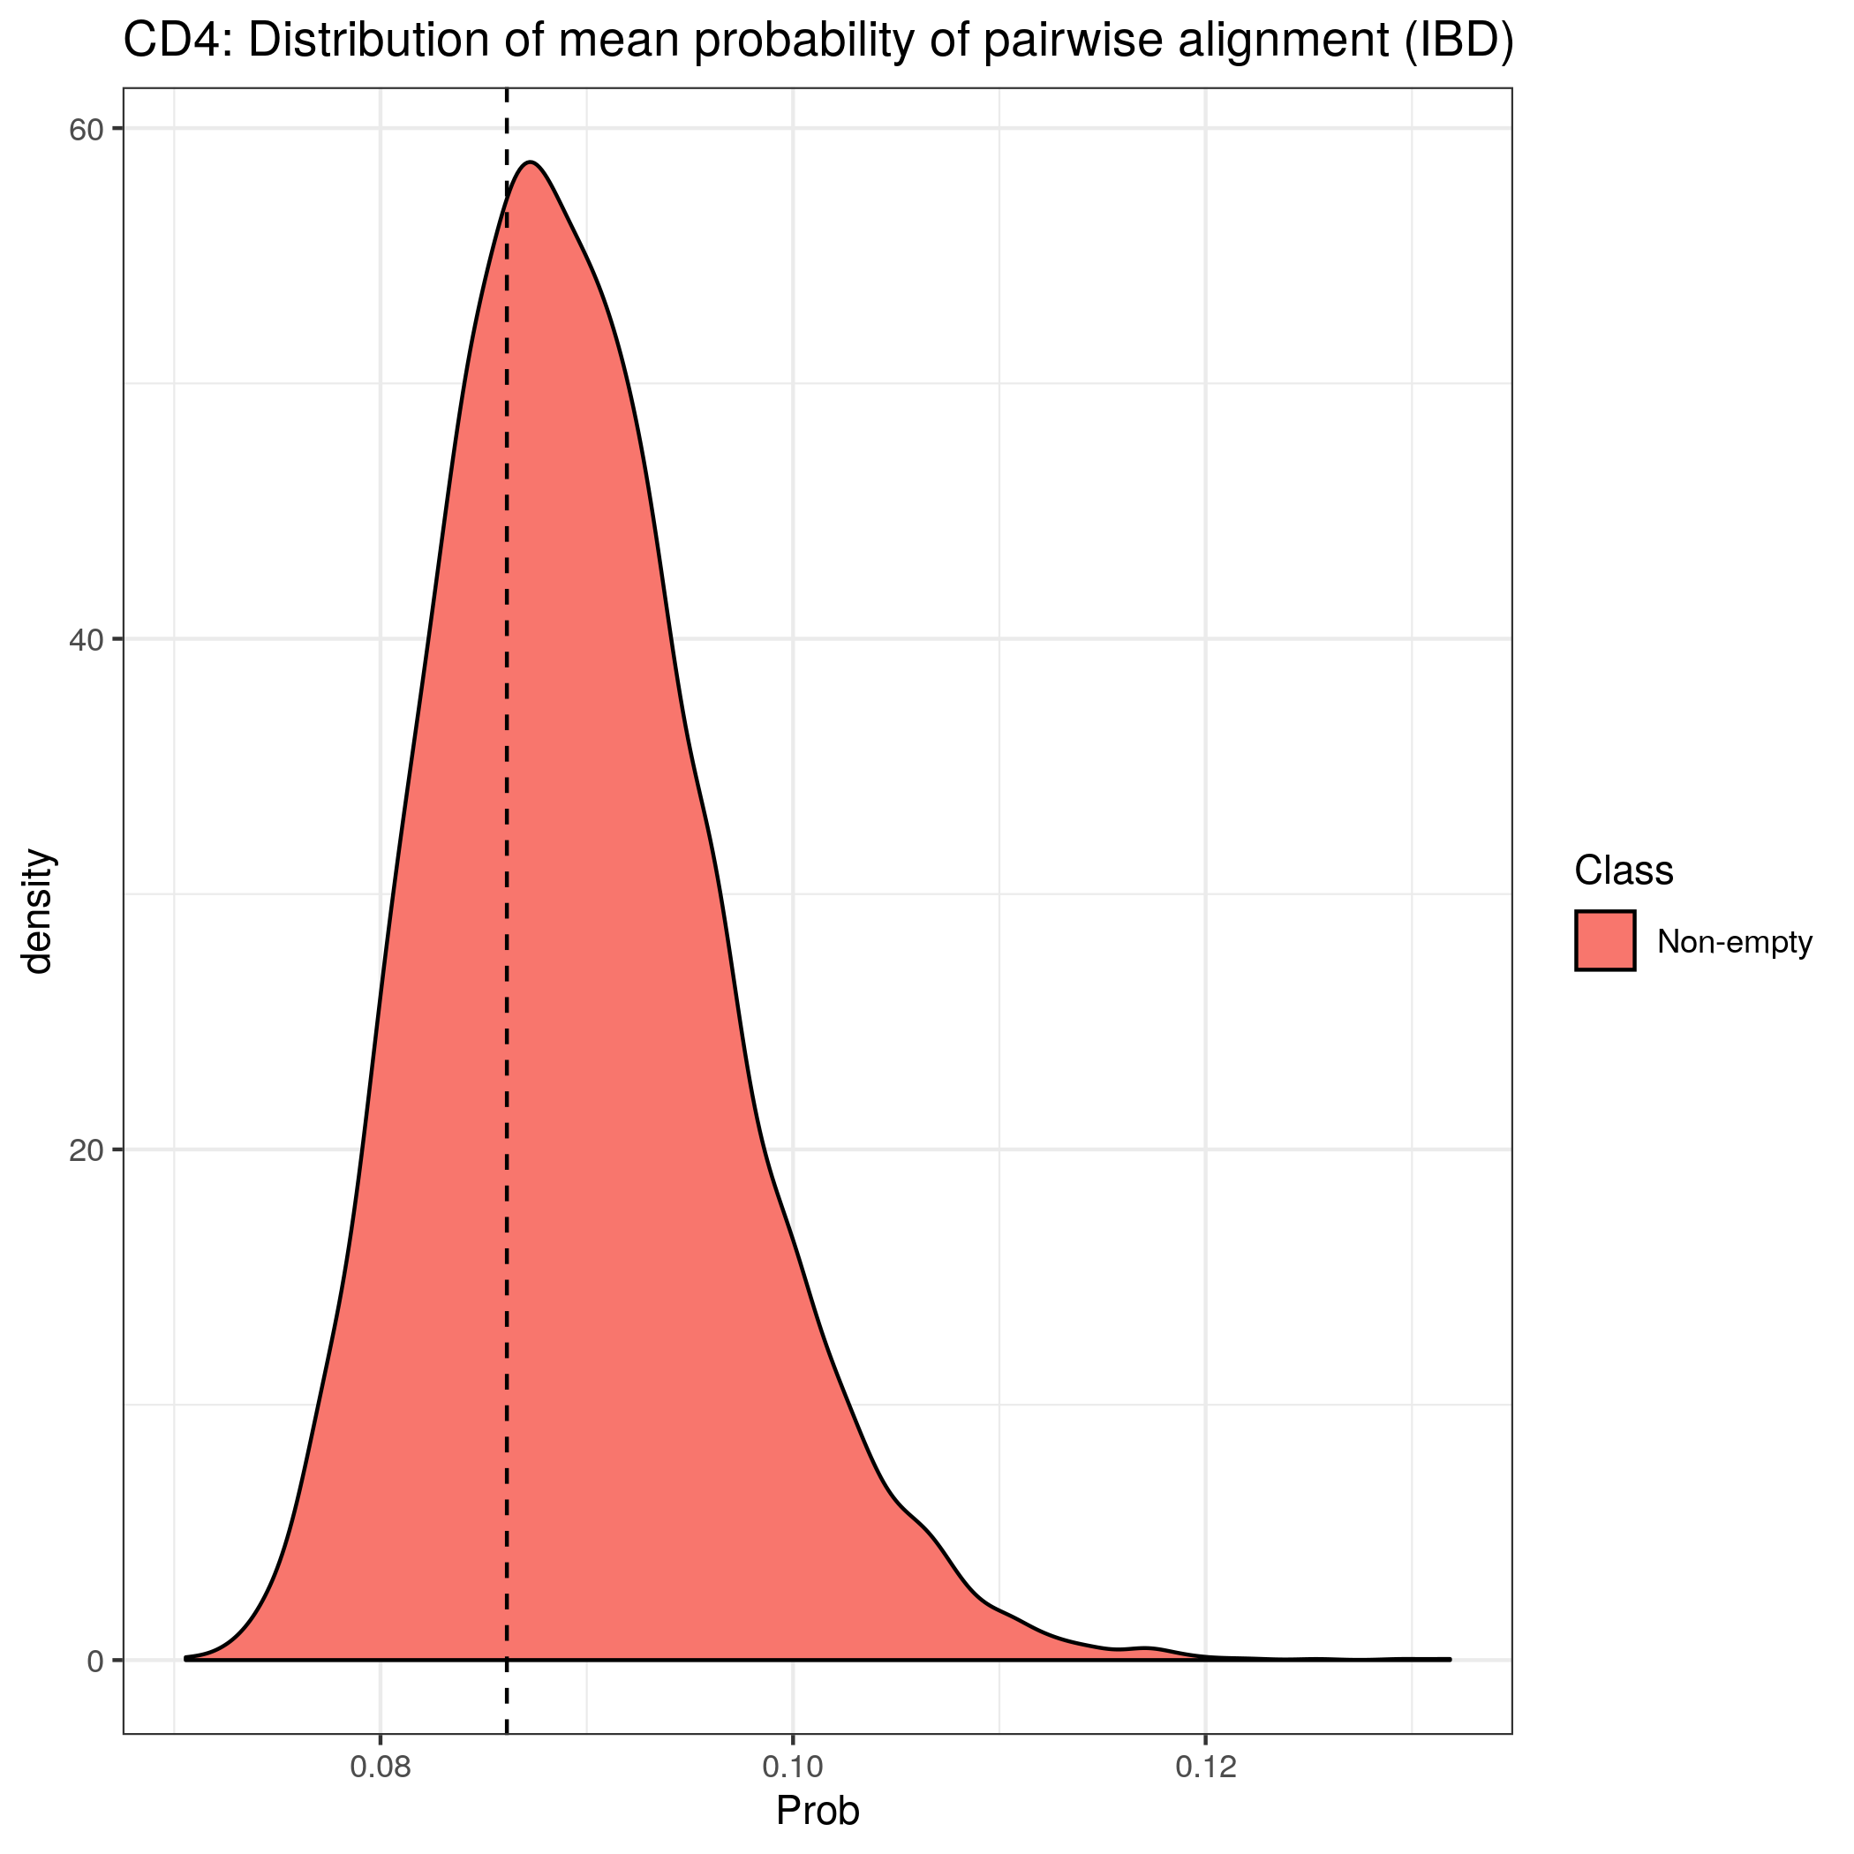
CEDAR 2: Results
Compare mean pairwise probability of alignment for IBD genes in CD4.
Suggests tissue-specific gene sets are necessary.
No obvious clustering structure for IBD genes here.

Slide 25
Conclusion
Consensus clustering:
Describes a clustering space consistent with a converged MDI model.
Overcomes problems associated with Bayesian clustering methods in high dimensional, multi-modal spaces.
“Stickiness”; and
Speed.
Tissue specific gene sets:
Encouraging results suggest that consensus clustering can uncover gene sets across tissues simultaneously; and
Exploratory analysis suggests tissue specific gene sets are necessary.

Slide 26
References
Matthew T. Weirauch. Gene Coexpression Networks for the Analysis of DNA Microarray Data. In Matthias Dehmer, Frank Emmert-Streib, Armin Graber, and Armindo Salvador, editors, Applied Statistics for Network Biology, pages 215–250. Wiley-VCH Verlag GmbH & Co. KGaA, Weinheim, Germany, April 2011. ISBN 978-3-527-63807-9 978-3-527-32750-8. doi:10.1002/9783527638079.ch11
Michael A. Mooney and Beth Wilmot. Gene set analysis: A step-by-step guide. American Journal of Medical Genetics Part B: Neuropsychiatric Genetics, 168(7):517–527, October 2015. ISSN 15524841. doi: 10.1002/ajmg.b.32328.
A. Subramanian, P. Tamayo, V. K. Mootha, S. Mukherjee, B. L. Ebert, M. A. Gillette, A. Paulovich, S. L. Pomeroy, T. R. Golub, E. S. Lander, and J. P. Mesirov. Gene set enrichment analysis: A knowledge-based approach for interpreting genome-wide expression profiles. Proceedings of the National Academy of Sciences, 102(43):15545–15550, October 2005. ISSN 0027-8424, 1091-6490. doi: 10.1073/pnas.0506580102.
Paul Kirk, Jim E. Griffin, Richard S. Savage, Zoubin Ghahramani, and David L. Wild. Bayesian correlated clustering to integrate multiple datasets. Bioinformatics, 28(24):3290–3297, December 2012. ISSN 1460-2059, 1367-4803. doi: 10.1093/bioinformatics/bts595.
Stefano Monti. Consensus Clustering: A Resampling-Based Method for Class Discovery and Visualization of Gene Expression Microarray Data. page 28.
The International IBD Genetics Consortium. IBD risk loci are enriched in multigenic regulatory modules encompassing putative causative genes. Nature Communications, 9(1):2427, December 2018. ISSN 2041-1723. doi:10.1038/s41467-018-04365-8.

